Slide 1

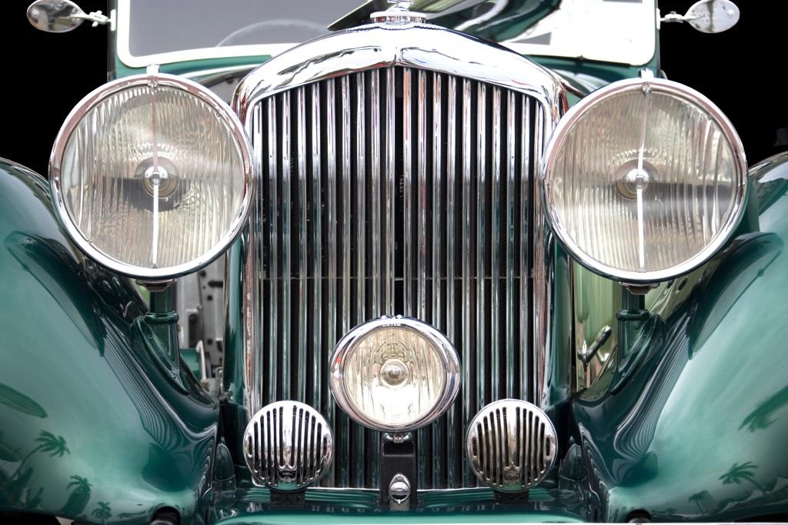
Vintage Car Event
Penn Liberty Motors

Slide 2
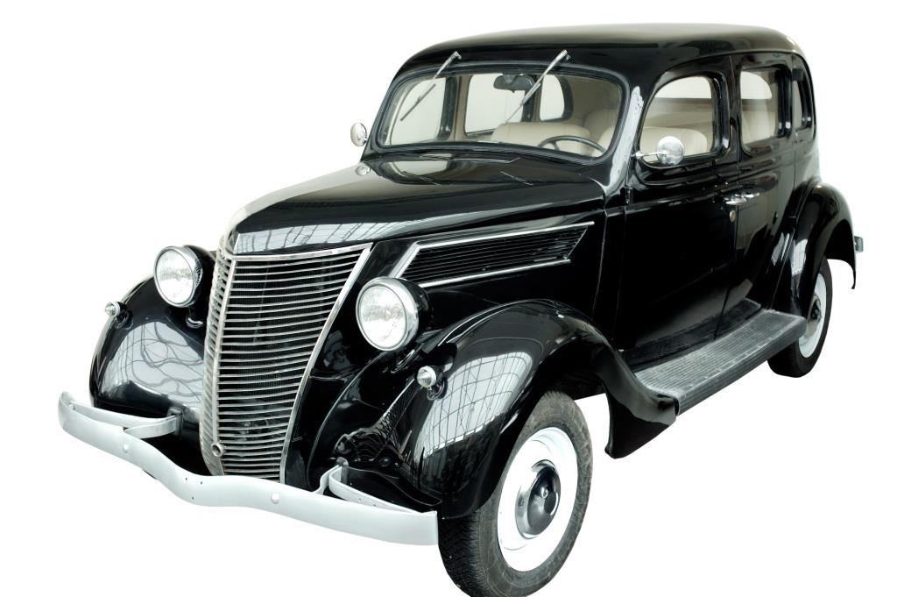
Classic Cars
Pre-World War I
Post-World War I
American
European

Slide 3
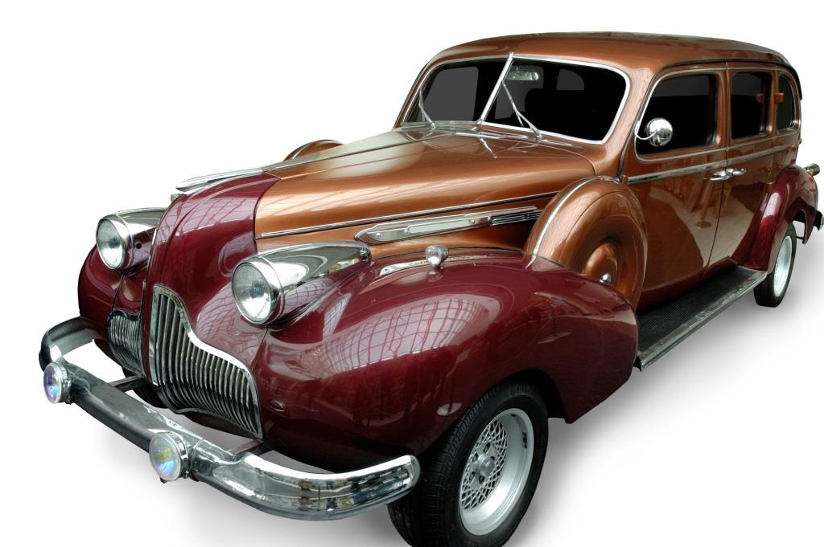
Exotic Cars
Luxury cars
One-of-a-kind cars
Concept cars

Slide 4
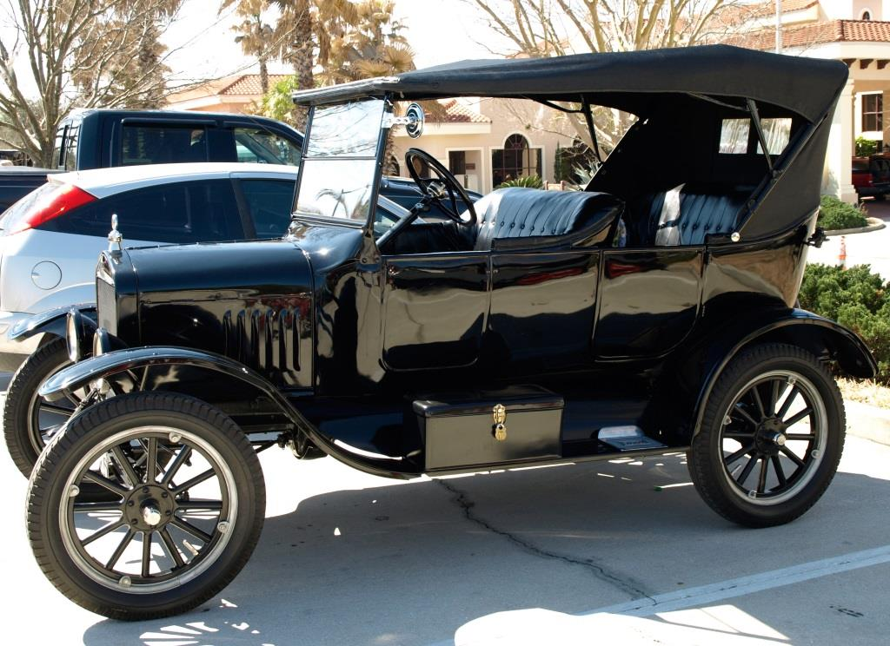
Antique Cars
Model A
Model T
Touring

